Slide 1
UniBuddy
Deepak Ayyasamy
Tarun Siga
Sai Karthik Naladala

Slide 2
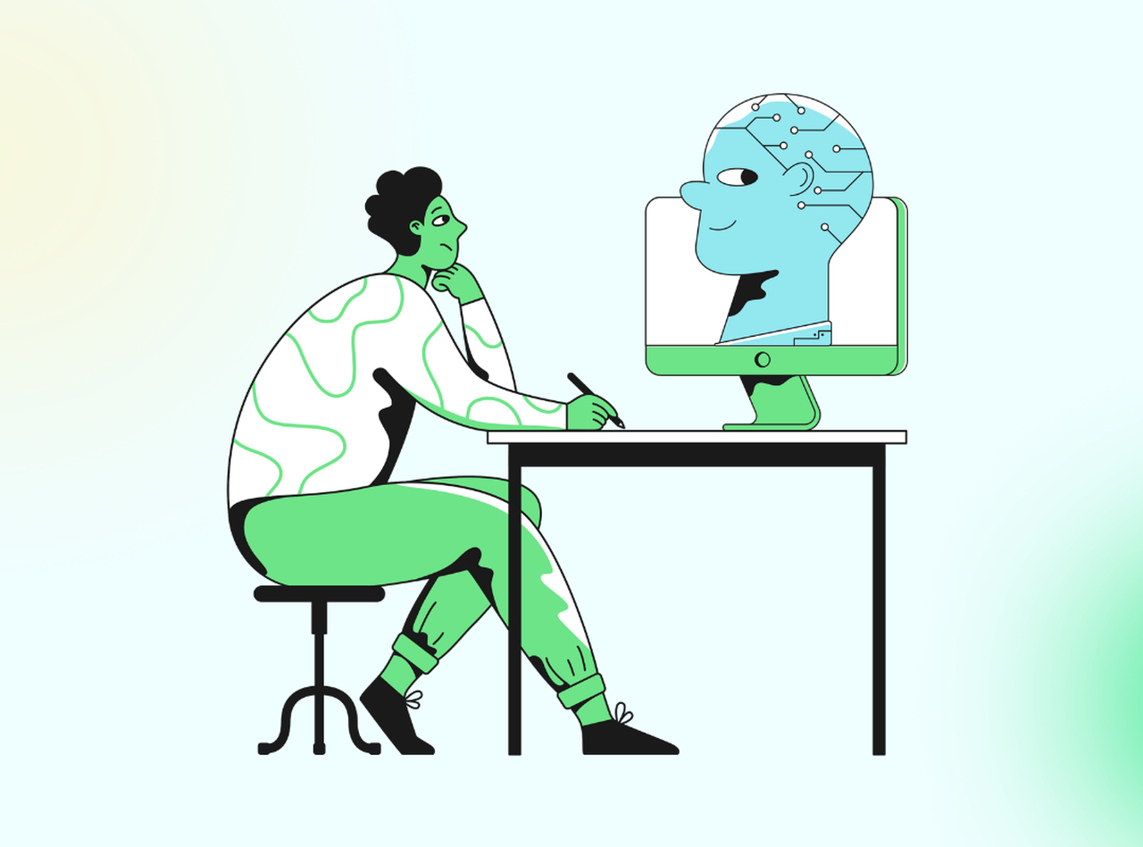
Offering Overview
UniBuddy is an AI personal assistant services tailored specifically for students in the US.
This service encompasses a comprehensive approach to academic support, including study skills, time management, and emotional assistance.
UniBuddy aims to bridge the gap between students and academic success by providing holistic guidance and personalized assistance to navigate through their educational journey effectively.

Slide 3
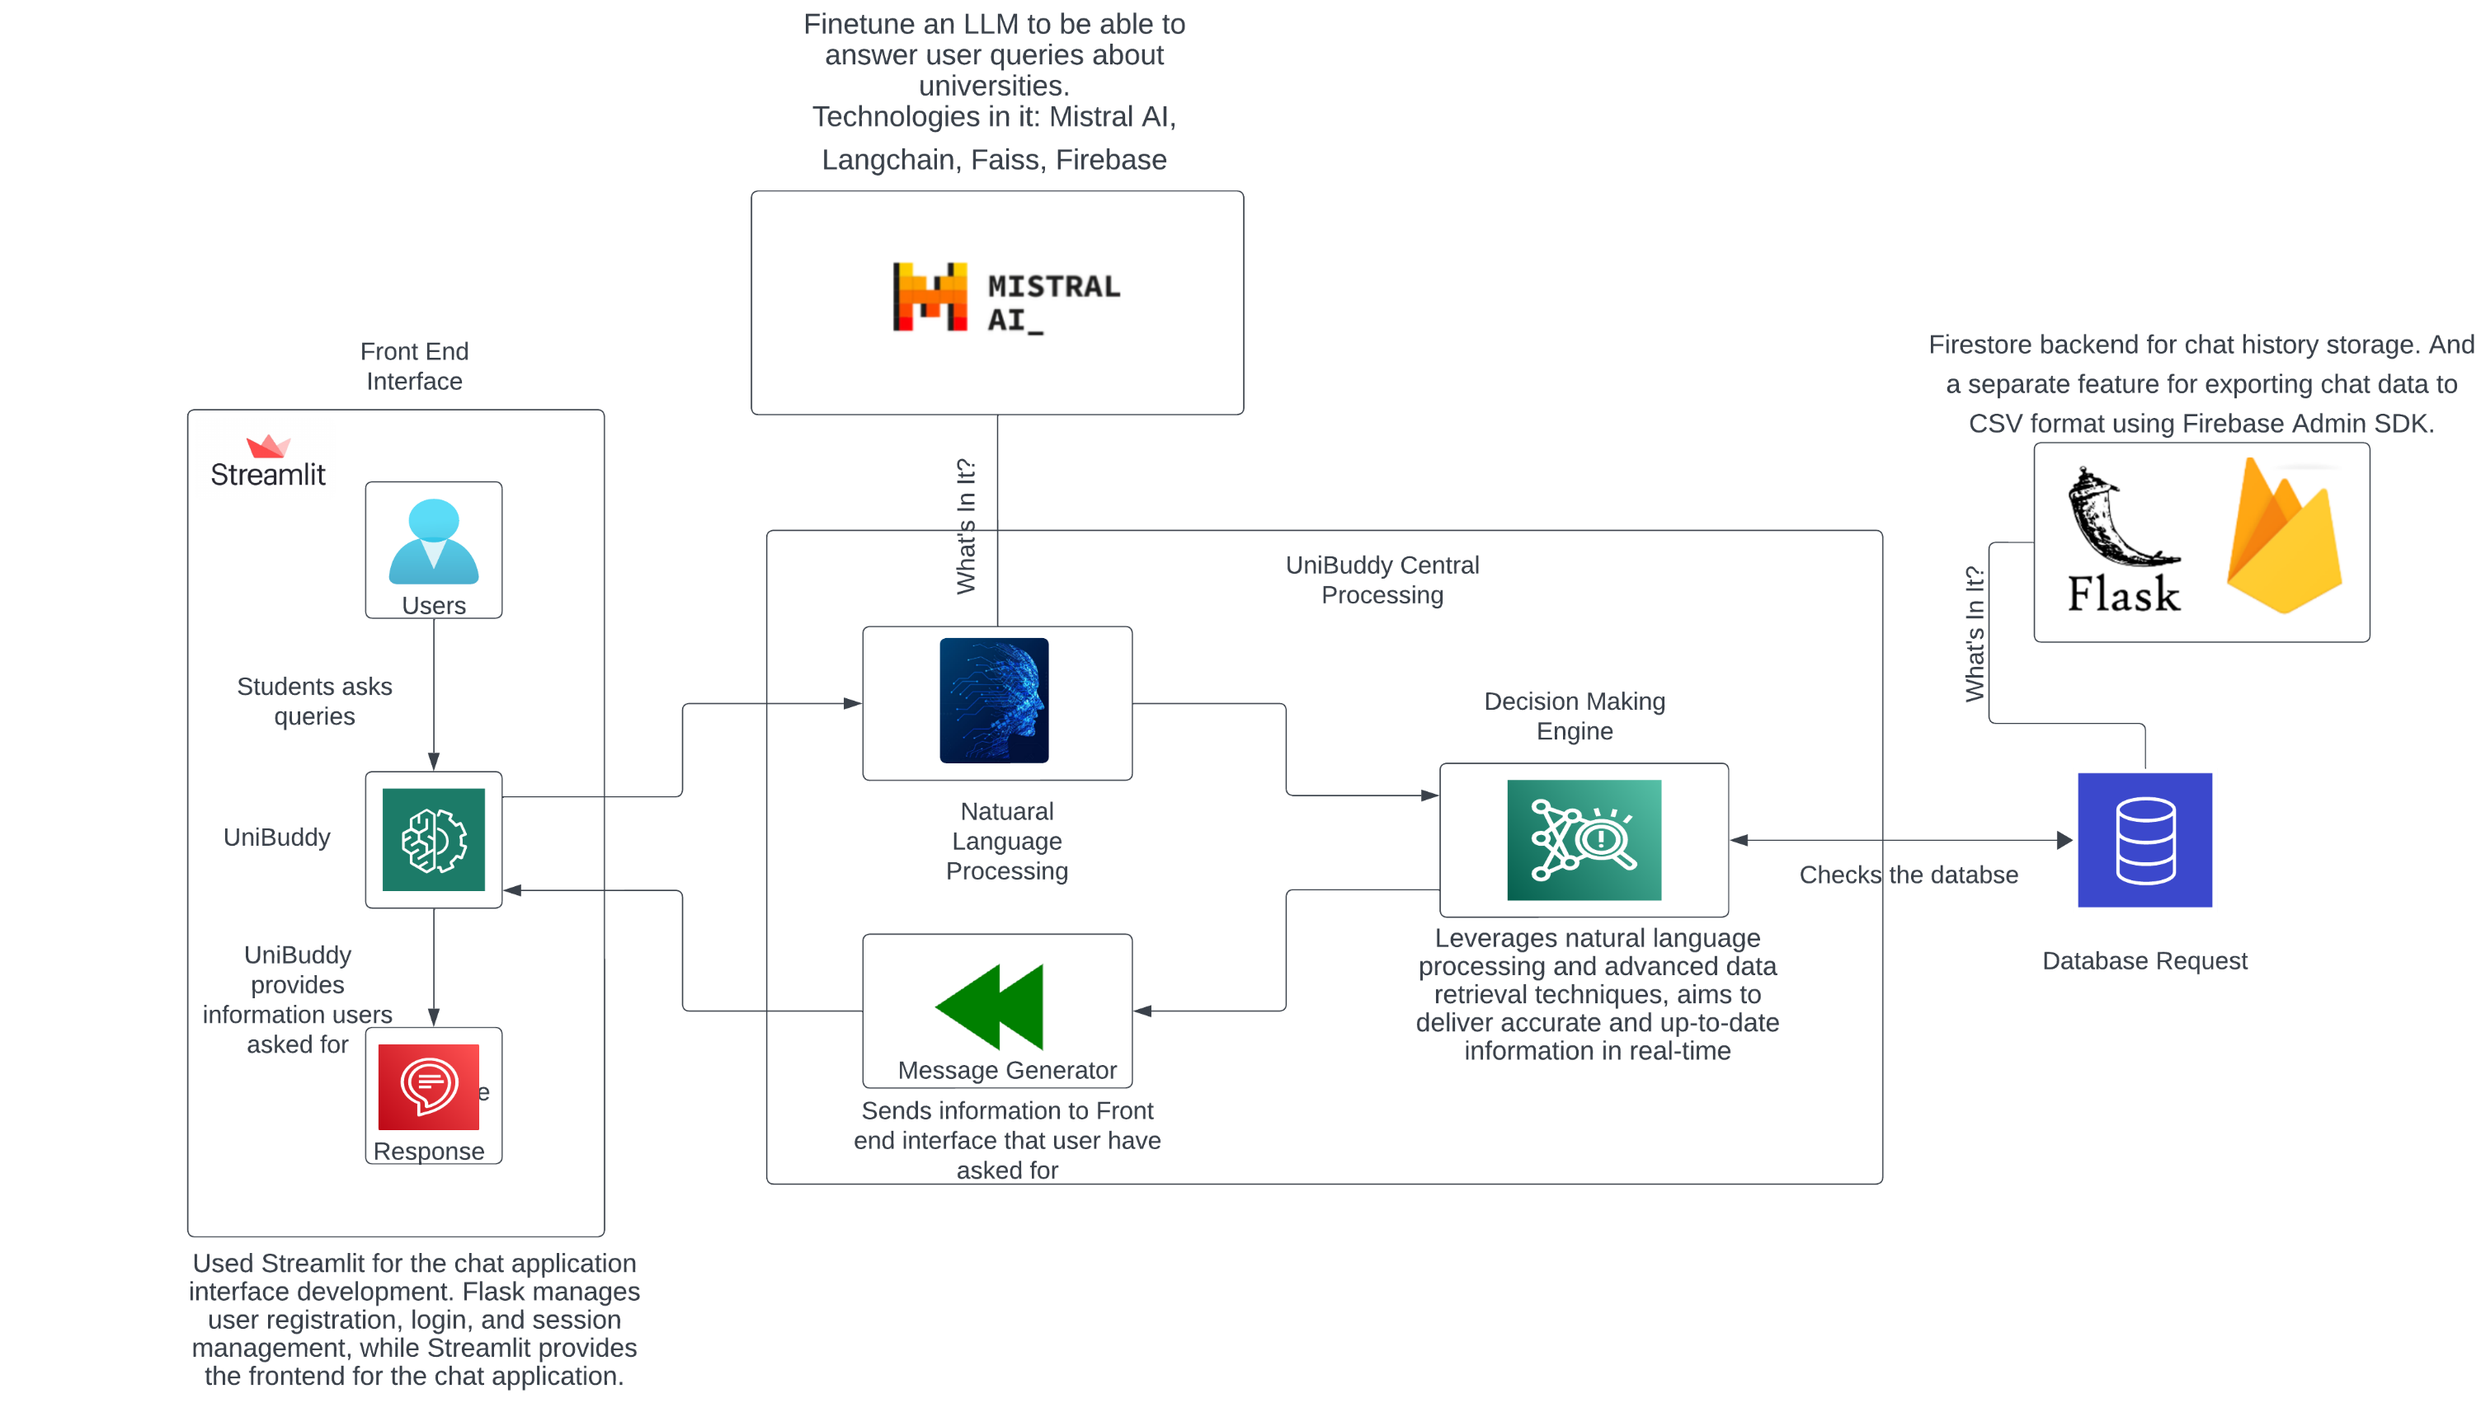
Concept Diagram

Slide 4
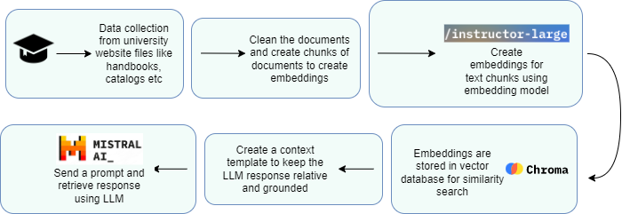
Model Diagram

Slide 5

Data Cleaning & Preparation
Relevant pdf files are downloaded and index files, synopsis etc are removed to prevent irrelevant information feeding into embedding model.
Convert documents into chunks to make sure text content can fit into LLM prompt for LLM fine-tuning.

Slide 6
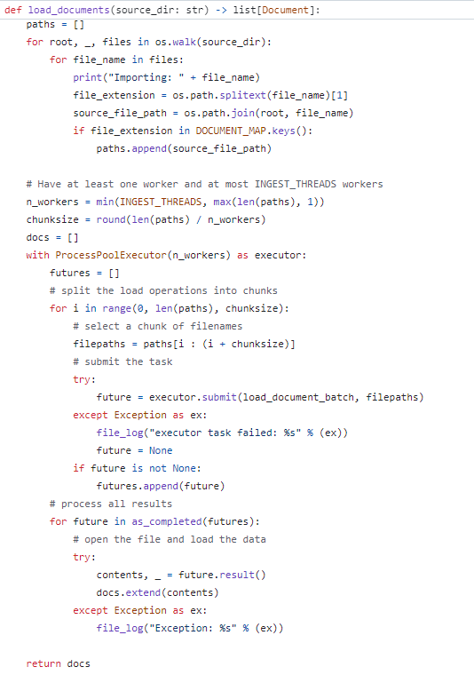
Embeddings
Create embeddings from text chunks using appropriate embeddings models.
“instructor-large” is used here based on its rating on embeddings of large files.
Created embeddings are stored in a vector database for similarity search. Chroma DB is used for storing created embeddings.

Slide 7
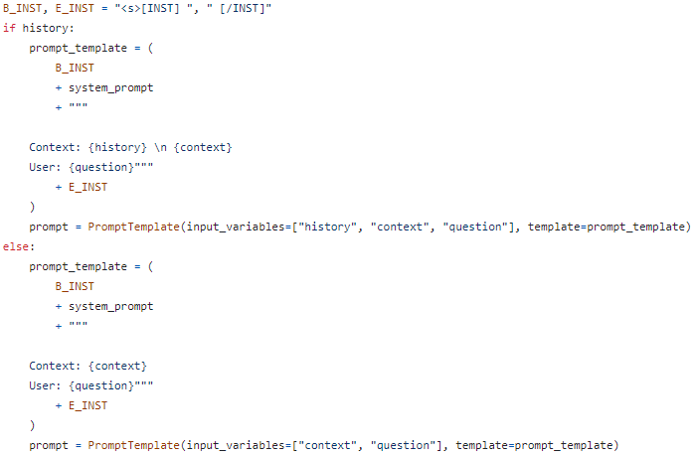
LLM implementation
Design retrieval prompt template to extract relevant responses from the LLM.
Once the user sends a query, the variables are fit in the prompt template and sent for inference.

Slide 8
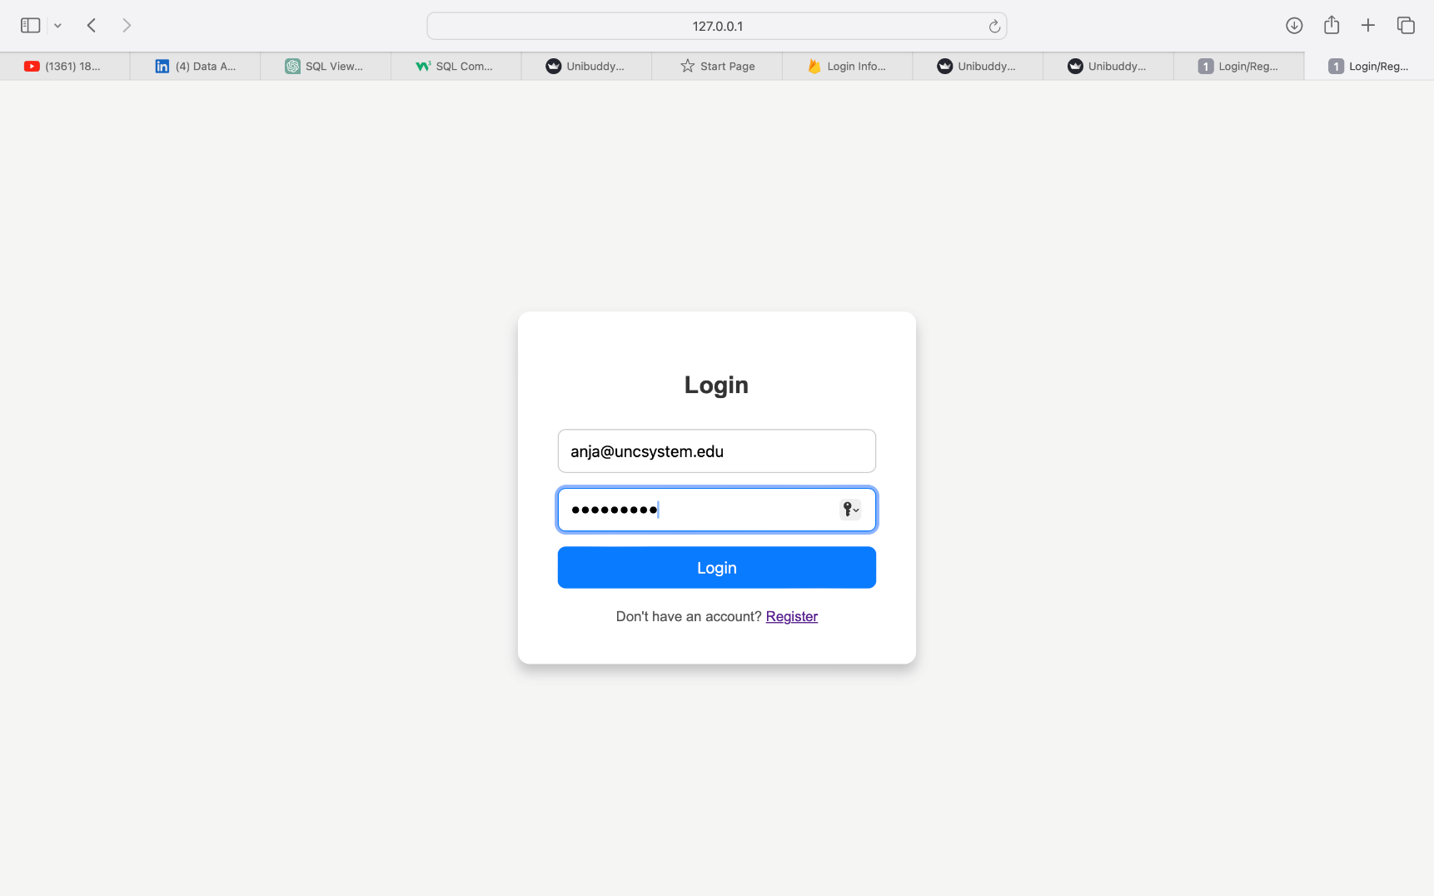
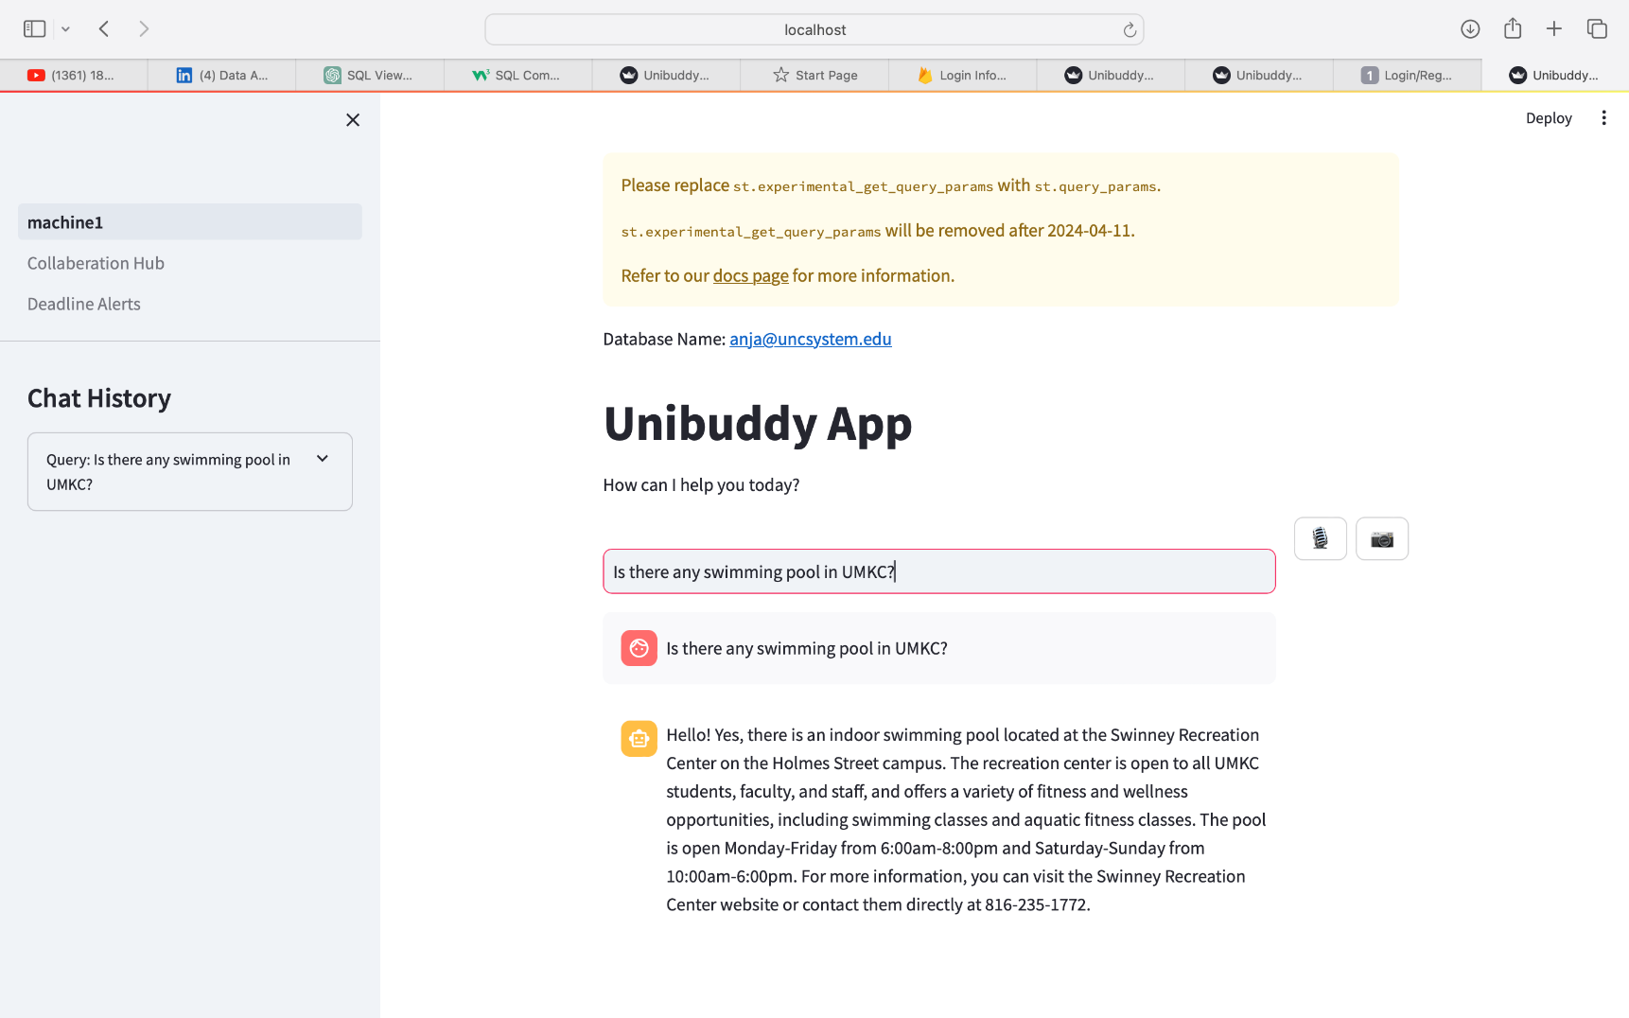
Initial Results

Slide 9

Future improvements
Design personalization using user-specific information gathering.
Implement real-time RAG fine-tuning by updating data chunks and keeping up the vector database.
Build new features into product like customized recommendations.

Slide 10
Questions ?

